Slide 1
House Rental Price Prediction Analysis
Frank McKenzie-Stripp, Mohammed Hamdouna, Zitarashe Okot

Slide 2
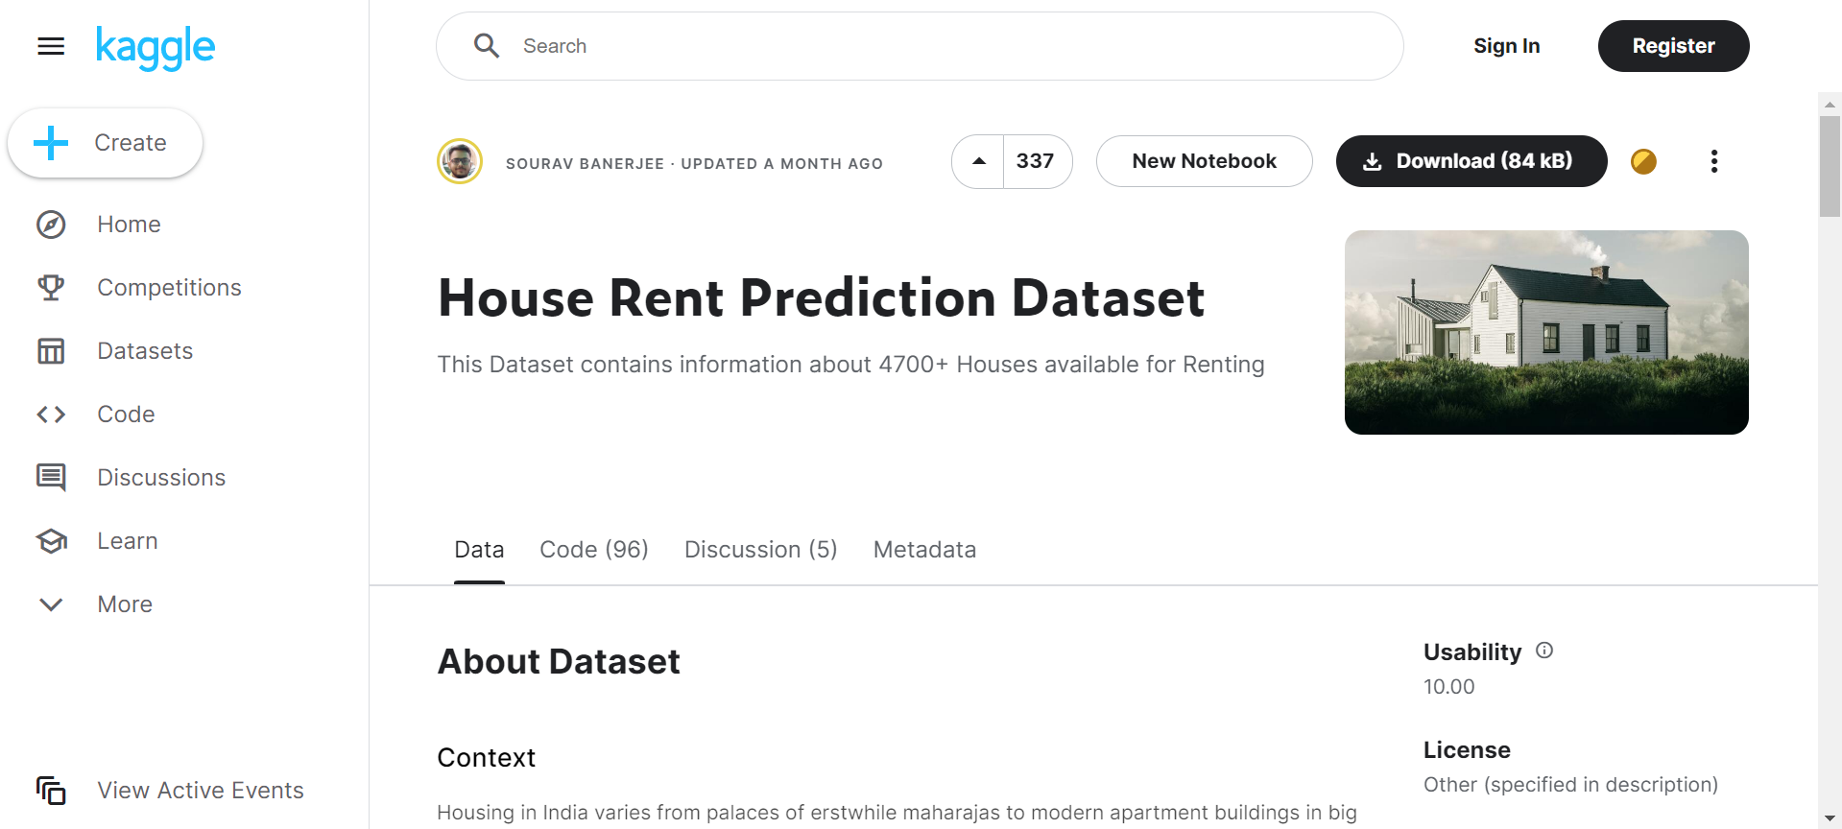
Where the dataset was found:

Slide 3
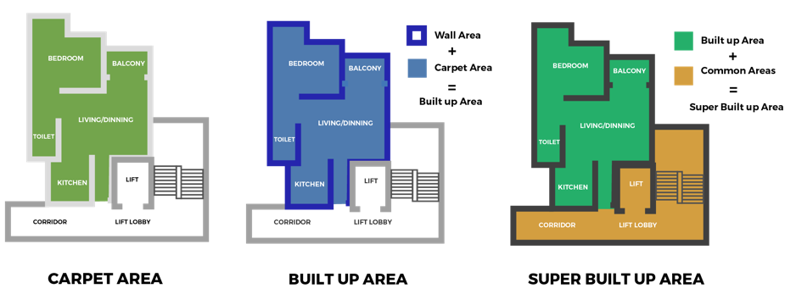
Definitions:
Super area: the built-up area and includes common spaces like lifts and stairs.
Carpet area: the area in the flat or the apartment, which you could cover using a carpet.
Build area: the greatest horizontal area of a building within the outside surface of the exterior walls.
BHK: bedrooms, halls, and kitchens.
Rental price: the monthly cost of rent (presumably in Indian Rupees)

Slide 4
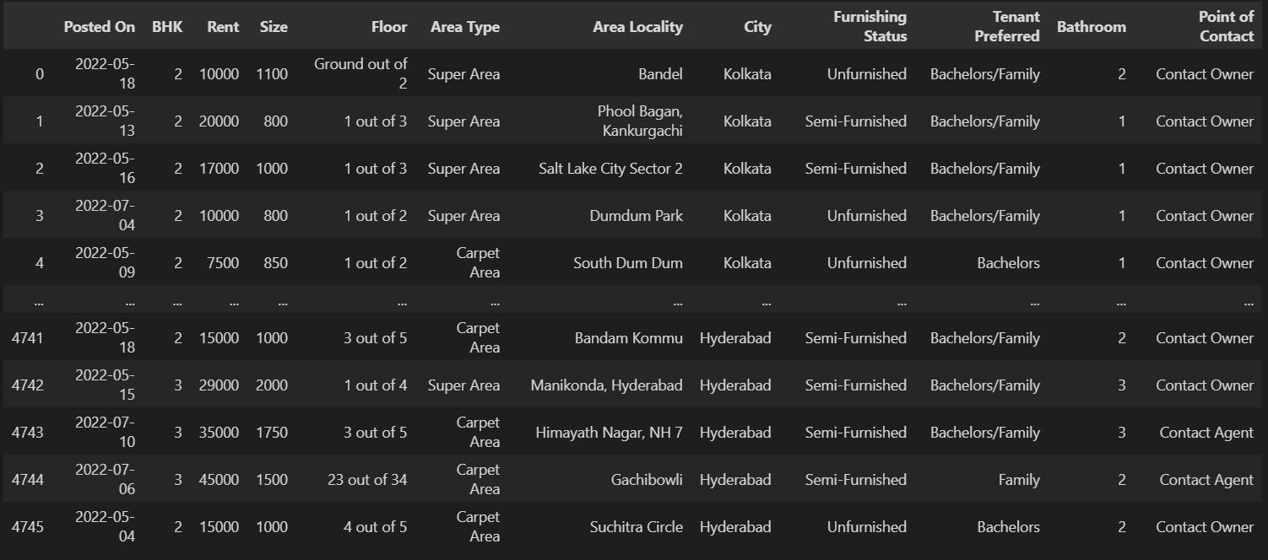
The Dataset:

Slide 5
The Questions:
Does the house size affect the rental price?
Does the area type affect the rental price?
Does city/location affect the price?
Does the furnishing status affect the price?
Does the point of contact affect the price?
Does the number of bathrooms affect the price?
Does the population affect prices?

Slide 6
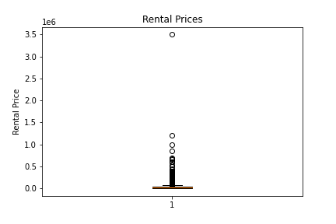
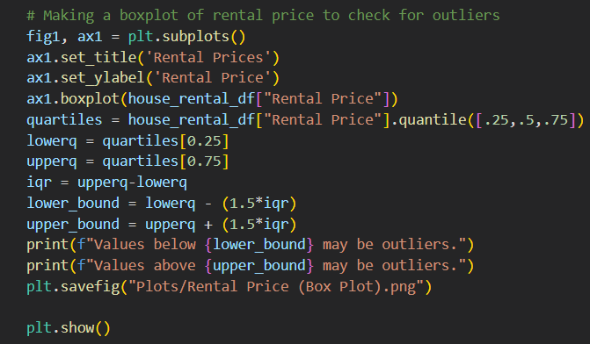
Box Plot & Outliers - Rental Prices
Values above 67500 may be outliers

Slide 7
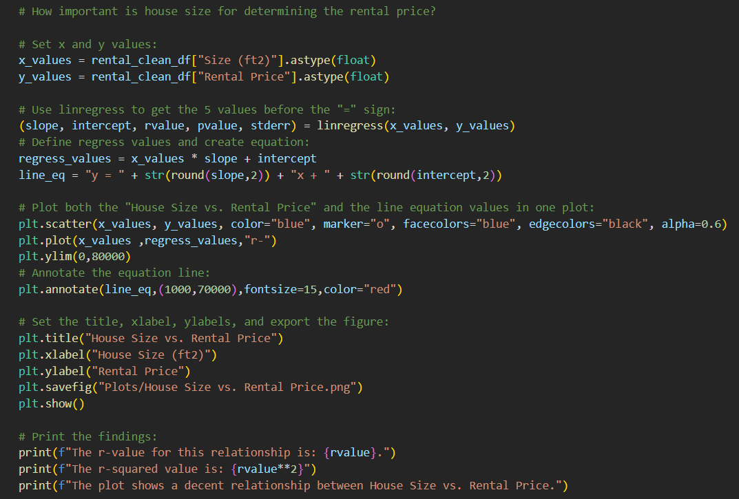
Data Analysis - Scatter Plots

Slide 8
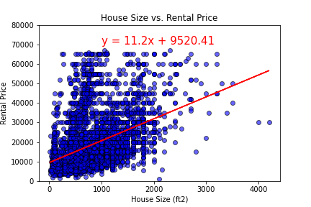
Hypothesis:
House size affects rental price.
- The r-value for this relationship is: 0.394
-The r-squared value is: 0.155

Slide 9
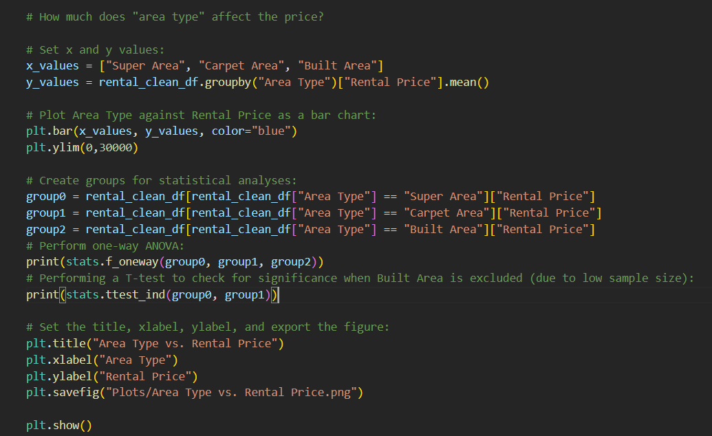
Data Analysis - Bar Graphs

Slide 10
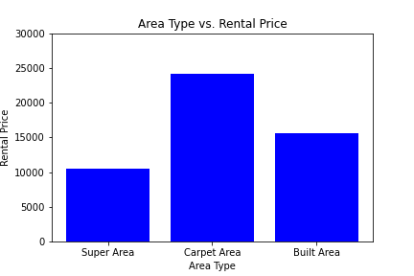
Hypothesis:
Super Area rentals have a lower rental price than others.
-P<0.0001
-Null hypothesis: rejected

Slide 11
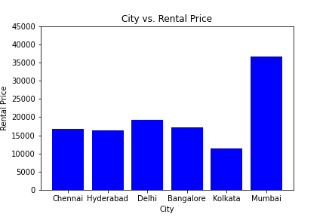
Hypothesis:
City affects rental prices.
-P<0.0001
-Null hypothesis: rejected

Slide 12
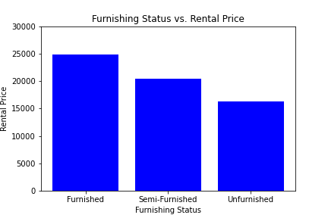
Hypothesis:
More furnished properties are more expensive.
-P<0.0001
-Null hypothesis: rejected

Slide 13
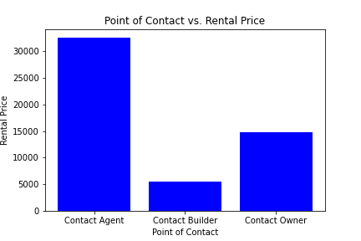
Hypothesis:
Contact agent rentals are more expensive.
-P<0.0001
-Null hypothesis: rejected

Slide 14
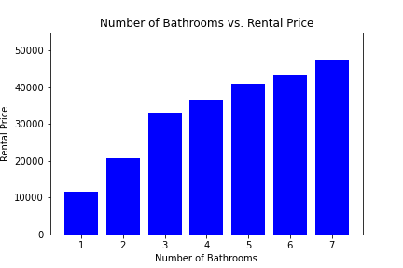
Hypothesis:
Rental price increases with number of bathrooms
-P<0.0001
-Null hypothesis: rejected

Slide 15
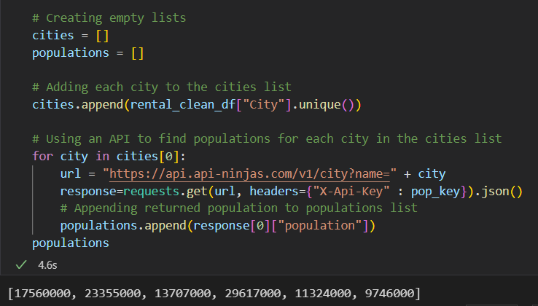
Hypothesis:
Population affects rental prices.
-P<0.0001
API used is API Ninjas - City API ; found at: https://api-ninjas.com/api/city

Slide 16
Summary
The following variables affect rental prices:
House Size
Area Type
City
Furnishing Status
Point of Contact
Number of Bathrooms
Population

Slide 17
Conclusions
Implications:
Rental properties measured by carpet area appear to be the most expensive.
It appears Mumbai is the most expensive city.
The more furnished a property is - the more expensive it seems to be.
Contact Agent seems to be the most expensive point of contact.
It seems that the more bathrooms a rental property has, the more expensive it will be.
It appears that population affects the rental price.
Limitations and Future Directions:
ANOVA doesn’t specify which factor is significantly different, or between which groups significant differences lie.
Post-hoc analysis needed to provide further insight and confirm findings.

Slide 18
Thanks for listening!

